Slide 1
QUANTITATIVE STRATEGY CASE INTERVIEW
By Yu Zhen Lin

Slide 2
Data Sources
HDB Resale Flat Transactions from year 1990 to 2022
HDB Addresses with Geographic Coordinates
MRT data with Geographic Coordinates
Certificate of Entitlement (COE) Bidding Exercise Results

Slide 3
Section 1: Data Visualisation
Question A*: Show an overview of the number of property transactions, median price across the
years. Provide both a view at the national level, as well as by HDB towns. Your dashboard should also
provide functionality to filter based on Flat Type (e.g. look at only 5 Room flats).
Tableau link

Slide 4
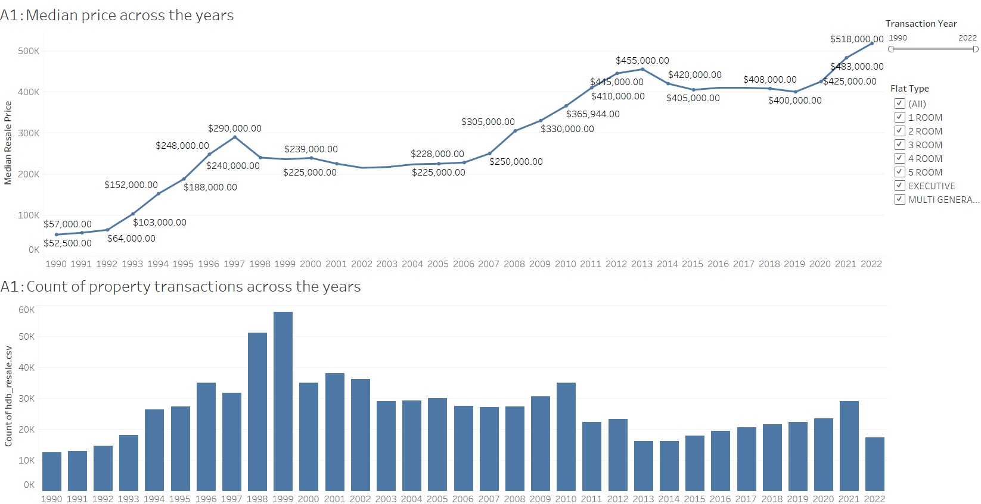
the number of property transactions, median price across the years
Transaction Year
Flat Type

Slide 5
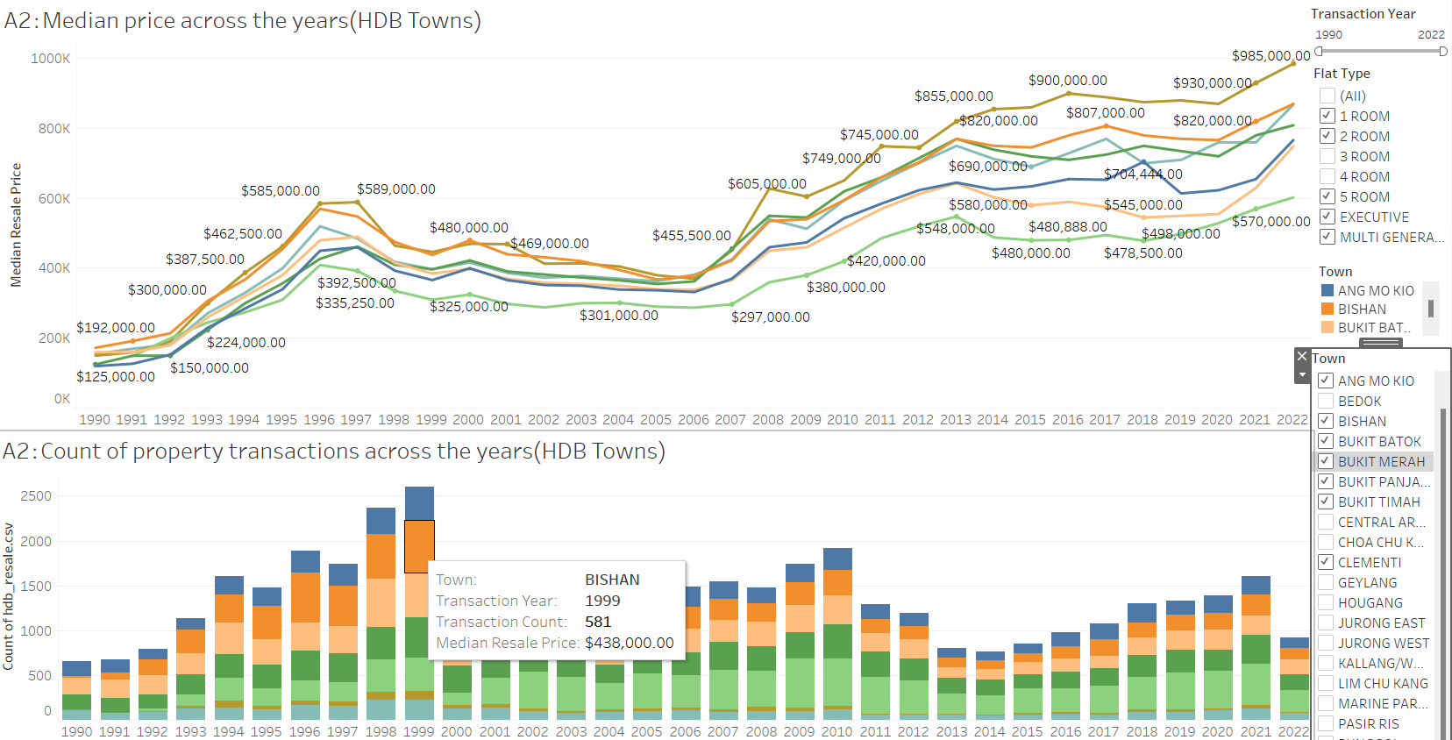
the number of property transactions, median price across the years by HDB towns
Transaction Year
Flat Type
Town
Tooltips

Slide 6
Section 1: Data Visualisation
Question B**: Some buyers would want to get the largest flat possible within a given budget. Create a dashboard to allow potential buyers to input their budget, and then suggest towns where such flats exist based on historical transactions

Slide 7
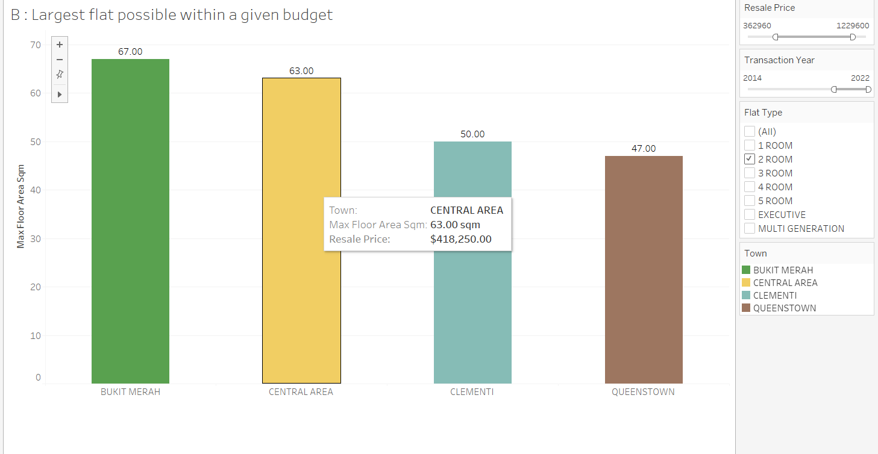
Largest flat possible within a given budget
budget
Transaction Year
Flat Type

Slide 8
Section 1: Data Visualisation
Question C***: There are buyers who would like to optimise given the proximity of a flat to important
locations in the neighbourhood, such as the nearest MRT station. Create a dashboard that allows
buyers to: i) input their budget; and ii) optimise flat selection given distance to important locations around the neighbourhood.

Slide 9
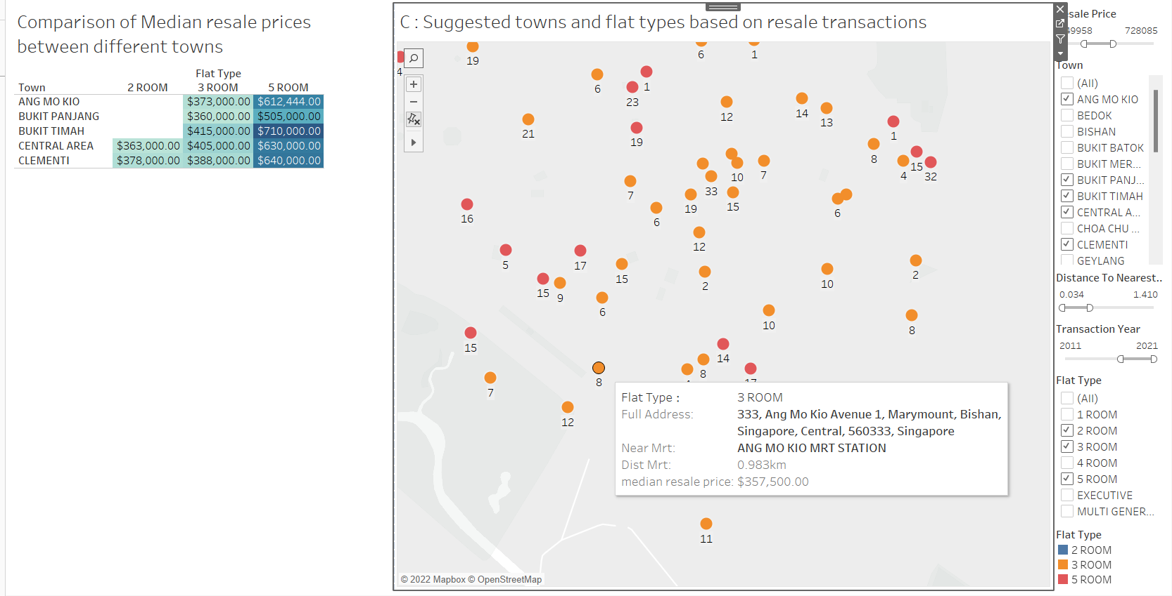
Suggested towns and flat types based on resale transactions
budget
Town
Distance to nearest MRT
Transaction Year
Flat Type

Slide 10
Section 2: Data Modeling
Question A*: Predict a resale flat price’s transaction price in 2014. Use the following characteristics : flat type, flat age and town. Propose and implement a minimum of three models, select the best model, and explain the reasons for your choice.

Slide 11
Model Comparisons
Data: 2014 resale transaction data
Feature
flat type, flat age and town
 | Train r2 score | Train RMSE | Test r2 score | Test RMSE
Linear Regression | 0.82 | $52221.98 | 0.82 | $51478.31
Ridge | 0.82 | $52597.45 | 0.82 | $51564.68
Random Forest | 0.92 | $34813.77 | 0.90 | $38912.51
Random forest has r2=0.9 which is higher than the linear regression and ridge models (0.82). In addition, rmse=38912 is also smaller than other models, so we think random forest is the best model

Slide 12
Section 2: Data Modeling
Question B**: A flat was sold in Nov 2017 with the following characteristics:
Flat type: 4 ROOM
Town: Yishun
Flat Model: New Generation
Storey Range: 10 to 12
Floor Area (sqm): 91
Lease Commence Date: 1984
Resale Price: 550,800
Was this a reasonable price for the transaction? How confident are you in your assessment?

Slide 13
Model Prediction
OLS Regression to get confidence interval
Data: 2017 resale transaction data
Feature:
Flat type, Town, Flat Model, Store Range, Floor Area, Age(Lease Commence Date)
Predict Resale Price Confidence Interval:(280981.21, 449269.37)
Conclusion:
550800 has exceeded the upper limit, indicating the price is unreasonable, there is a 95% probability to guarantee the reasonable price is within the above confidence interval

Slide 14
Section 2: Data Modeling
Question C***: Someone mistakenly deleted the column containing data on Flat Type in the database.
While backups exist, these data are critical to HDB’s daily operations, and time would be needed to
restore these data from the backup. Senior management would like you to create a model to predict
flat type given a transaction’s other characteristics. Explain the reasons for choosing this model.

Slide 15
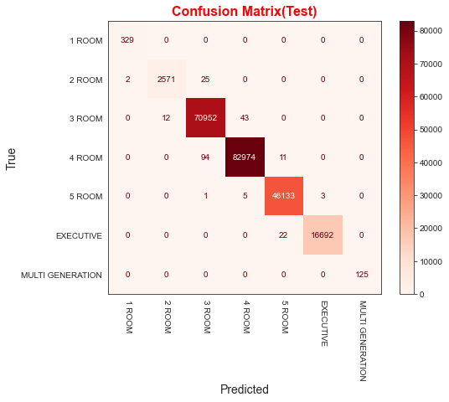

Model Comparisons
Random Forest
Bagging

Slide 16
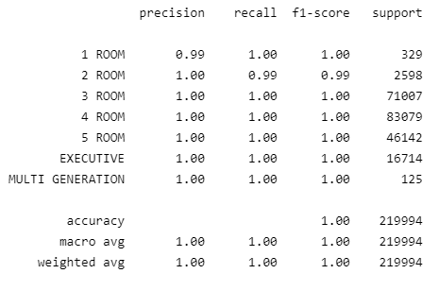
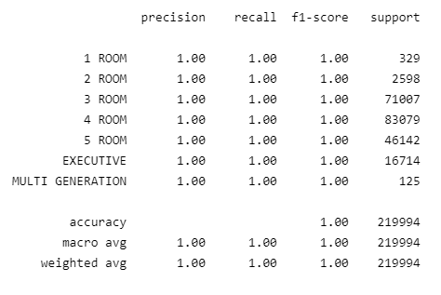
Model Comparisons
Bagging
Random Forest
Bagging Classifier is chosen because it has better performance in test dataset based on the comparisons of confusion matrix and classification report.

Slide 17
Section 3: Policy Analysis
Question A*: Yishun has received a negative reputation as “Crazy Town”, and property prices might
have been impacted. Are Yishun flats the cheapest in the country?

Slide 18
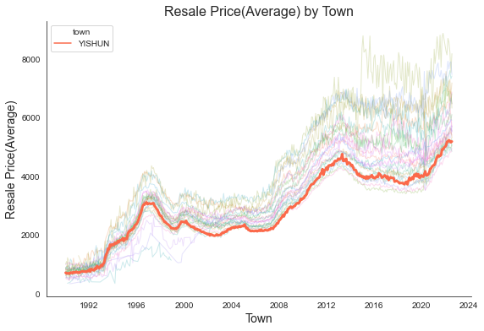
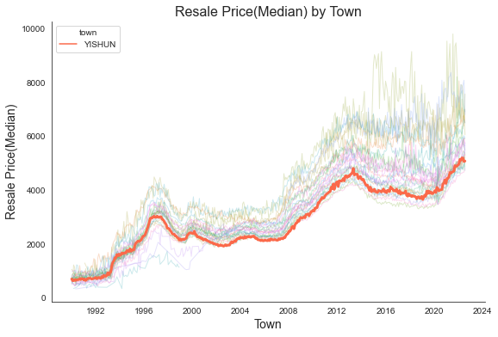
Resale Price per sqm across the years
Yishun has been almost the cheapest town across the years.

Slide 19
Section 3: Policy Analysis
Question B*: Some members of public have been saying that flat sizes have gotten smaller over the
years. Is there any truth in this statement?

Slide 20
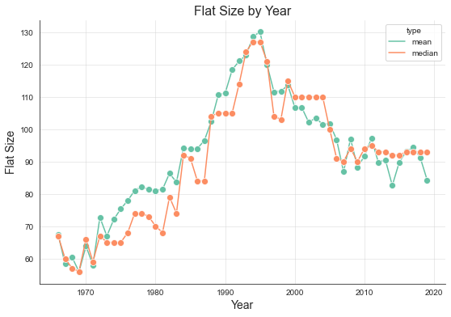
Flat sizes over the years
In the early stage, the flat size was increased, from 1990 to present, the flat size of new HDBs has gotten smaller over the years.

Slide 21
Section 3: Policy Analysis
Question C**: The Downtown Line Stage 2 connects the Bukit Panjang heartland to the city. Have
prices increased for resale flats in the towns served by this Line? You might want to use a differencein-differences model for this task.

Slide 22
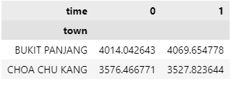
Differencein-differences model analysis
the treatment group
BUKIT PANJANG
the comparison group
CHOA CHU KANG
DTL2 was commenced revenue operations on Dec 2015, so the period we chosen for comparison is between Jan 2015 and Dec 2016.
Comparing the average price of the two towns in different periods, it seems that the price of BUKIT PANJANG has increased slightly.

Slide 23
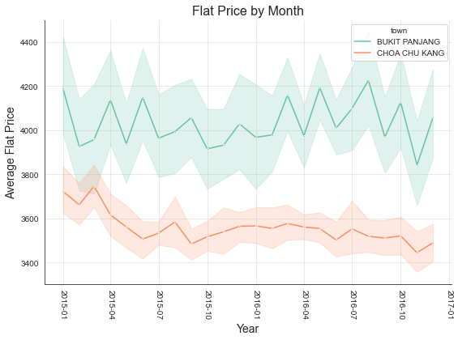
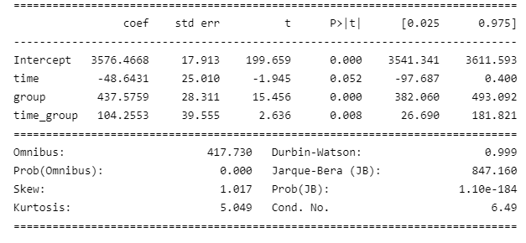
Differencein-differences model analysis
The Flat Price by month comparison
OLS Regression Results

Slide 24
Differencein-differences model analysis
The p-value of time_group is 0.008, which indicates that there are obvious differences in the house prices of different towns in different time periods.
The coefficient value of 104 is positive, indicating the resale price of BUKIT PANJANG flats was increased compared to its comparison group CHOA CHU KANG.

Slide 25
Section 3: Policy Analysis
Question D***: There have been comments online that people are buying flats in towns further from the city so that the cost savings can be used for a car. Are resale prices in HDB estates in areas further away from the city (i.e. Sengkang and Punggol) impacted by Certificate of Entitlement (COE) prices for cars?

Slide 26
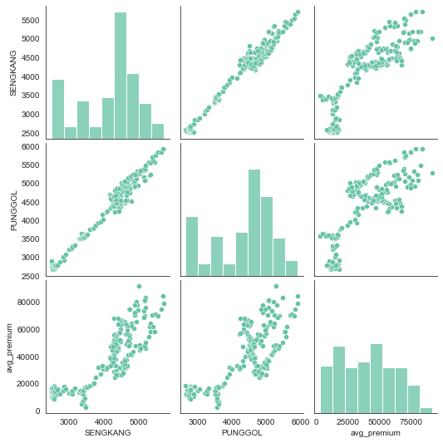
Correlation between coe price and Sengkang and Punggol resale price
Data
Certificate of Entitlement (COE) Bidding Exercise Results
We choose data of car A for analysis
SENGKANG,PUNGGOL resale price transactions

Slide 27
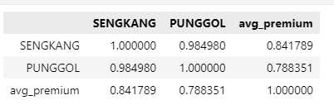
Correlation between coe price and Sengkang and Punggol resale price
The scatter plot is linear, indicating that the coe price is positively correlated with the housing prices of the two towns, and a correlation coefficient can also be given.
The correlation coefficient between SENGKANG house price and coe price is 0.84; the correlation coefficient between PUNGGOL house price and coe price is 0.79.

Slide 28
Q&A

